Slide 1
Middleware for Data Management
Yuwei Liang,Xin Jin, Bige Xiang

Slide 2
Transaction Processing Monitor
Origin of TP Monitors
Purpose of TP Monitors
What are TP Monitors?
What do TP Monitors do?
Example of a TP Monitors
Features of TP Monitors

Slide 3
Origin of TP Monitors
TP monitor technology emerged when Atlantic Power and Light created an online support environment to share concurrently applications services and information resources with the batch and time sharing operating systems environment.

Slide 4
Purpose of TP Monitors
Transaction processing (TP) monitor technology provides the distributed client/server environment the capacity to efficiently and reliably develop, run, and manage transaction applications.

Slide 5
What are TP Monitors?
A TPM is a standalone program, distinct from the Web server and app server.
TP monitor technology controls transaction applications and performs business logic/rules computations and database updates.
TP monitor technology is used in data management, network access, security systems, delivery order processing, airline reservations, and customer service.

Slide 6
What do TP Monitors do?
Its mission is to monitor workflow status for transactions that require multiple steps. The TPM generally has the capability to post alerts and rollback errors or generate compensating transactions when an error occurs.

Slide 7
Examples of TP Monitors
CICS (Customer Information Control System) by IBM.
TUXEDO by BEA.

Slide 8
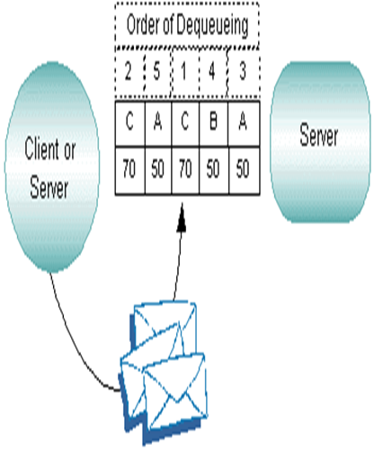
Features of TP Monitors
Priorities determine the order in which service requests are dequeued by a server. Priority is assigned by a client to individual services and can range from 1 to 100, where 100 represents the highest priority.

Slide 9
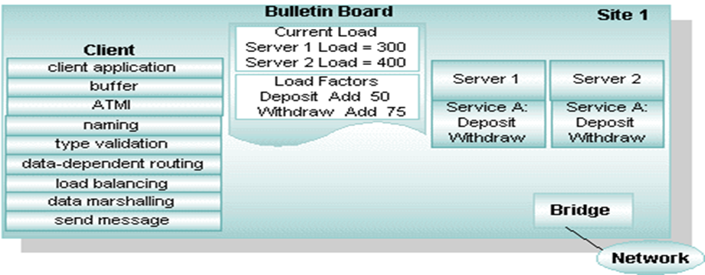
Features of TP Monitors
Load balancing: a technique used for distributing service requests evenly among servers that offer the same service.

Slide 10
Other features of TP Monitors
Data compression
Data encoding
Data encryption
Event management
Security management

Slide 11
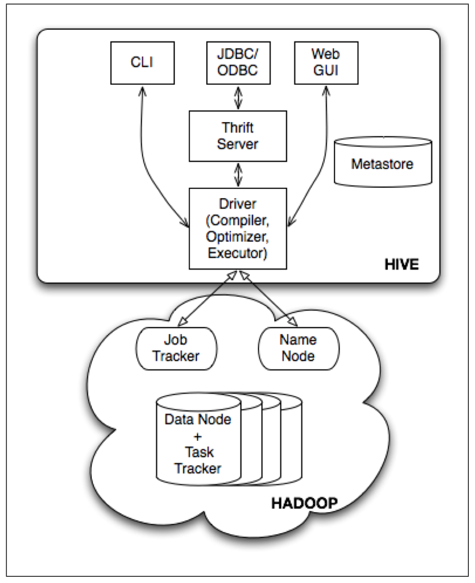
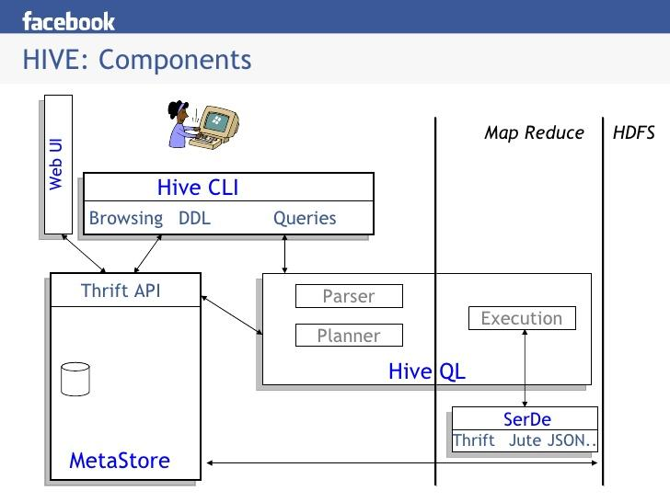
HIVE-Introduction
Definition: An open-source data warehousing solution built on top of Hadoop.
Basic Work Flow: HQL->MapReduce->Retrieving Data from HDFS(or other data stores)
Architecture:

Slide 12
HIVE-Important Components
Metastore
The storage system for the metastore should be optimized for online transactions with random accesses and updates. A file system like HDFS is not suited since it is optimized for sequential scans and not for random access. So, the metastore uses either a traditional relational database (like MySQL, Oracle) or file system (like local, NFS, AFS) and not HDFS.

Slide 13
HIVE-Important Components
Compiler
Converts a string(query statement, DDL) to a plan.
Parser: query string=>parse tree representation;
Semantic Analyzer: parse tree =>block-based internal query;
Logical Plan Generator: internal query=>logical plan(a tree of logical operators)
Optimizer:
1.combine multiple joins;
2.add repartition operators
3.early pruning columns (in order to minimize the amound of transferred data);
other user-provided hints.

Slide 14
HIVE-Features
Features
Provides a mechanism to project structure onto this data and query the data using a SQL-like language called HiveQL;
Support custom mappers/reducers.
Users can also add support for new data formats by defining custom serialize and deserialize methods (called SerDe’s) written in Java.

Slide 15
HIVE-Language
HiveQL
CREATE TABLE page_view(viewTime INT, userid BIGINT,
page_url STRING, referrer_url STRING,
ip STRING COMMENT 'IP Address of the User')
COMMENT 'This is the page view table'
PARTITIONED BY(dt STRING, country STRING)
STORED AS SEQUENCEFILE;
INSERT OVERWRITE TABLE user_active
SELECT user.*
FROM user
WHERE user.active = 1;

Slide 16
HIVE-Language
HiveQL
Using User-defined Map script
Example:
FROM (
FROM pv_users
MAP pv_users.userid, pv_users.date
USING 'map_script'
AS dt, uid
CLUSTER BY dt) map_output
INSERT OVERWRITE TABLE pv_users_reduced
REDUCE map_output.dt, map_output.uid
USING 'reduce_script'
AS date, count;

Slide 17
HIVE
More at: http://hive.apache.org

Slide 18
JDBC
The Java Database Connectivity (JDBC) API is the industry standard for database-independent connectivity between the Java programming language and a wide range of databases.
JDBC is oriented towards relational databases.
JDBC provides methods for querying and updating data in a database.
JDBC provides access to any kind of tabular data sources

Slide 19
JDBC API Overview
The JDBC API makes it possible to do three things:
Establish a connection with a database or access any tabular data source
Send SQL statements
Process the results

Slide 20
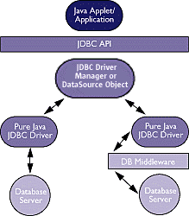
JDBC Architecture
Applications and applets can access databases via the JDBC API using pure Java JDBC technology-based drivers.
Left side: Direct-to-Database Pure Java Driver
Right side: Pure Java Driver for Database Middleware

Slide 21
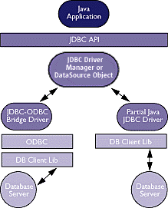
JDBC Architecture
JDBC connectivity using ODBC drivers and existing database client libraries.
Left side: JDBC-ODBC Bridge plus ODBC Driver
Right side: A native API partly Java technology-enabled driver

Slide 22
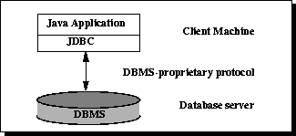
JDBC Architecture
Two-tier Architecture for Data Access
a Java applet or application talks directly to the data source
a client/server configuration
Data source may be located on another machine to which the user is connected via a network

Slide 23
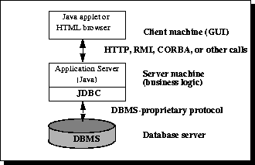
JDBC Architecture
Three-tier Architecture for Data Access
commands are sent to a "middle tier" of services
maintains control over access and the kinds of updates that can be made to corporate data
simplifies the deployment of applications
offers fast performance

Slide 24
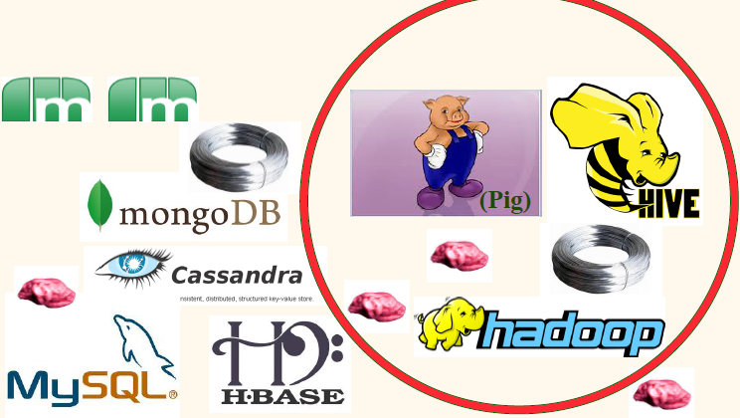
Today’s Tangled World

Slide 25

Today’s Tangled World

